Slide 1

Insurance
Lead gen tool
Fri 12
Version 2.0

Slide 2
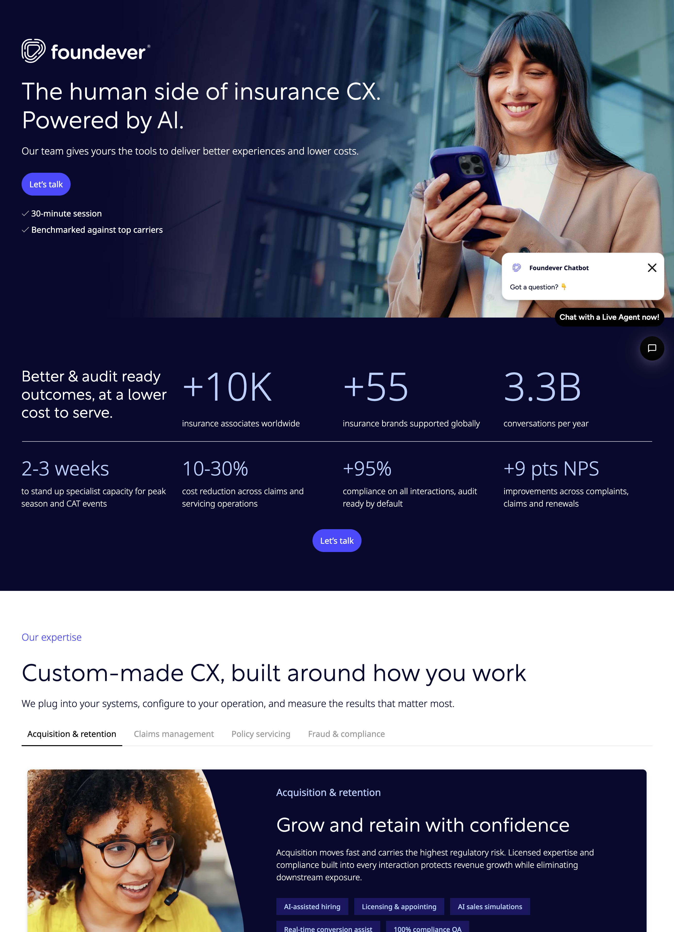
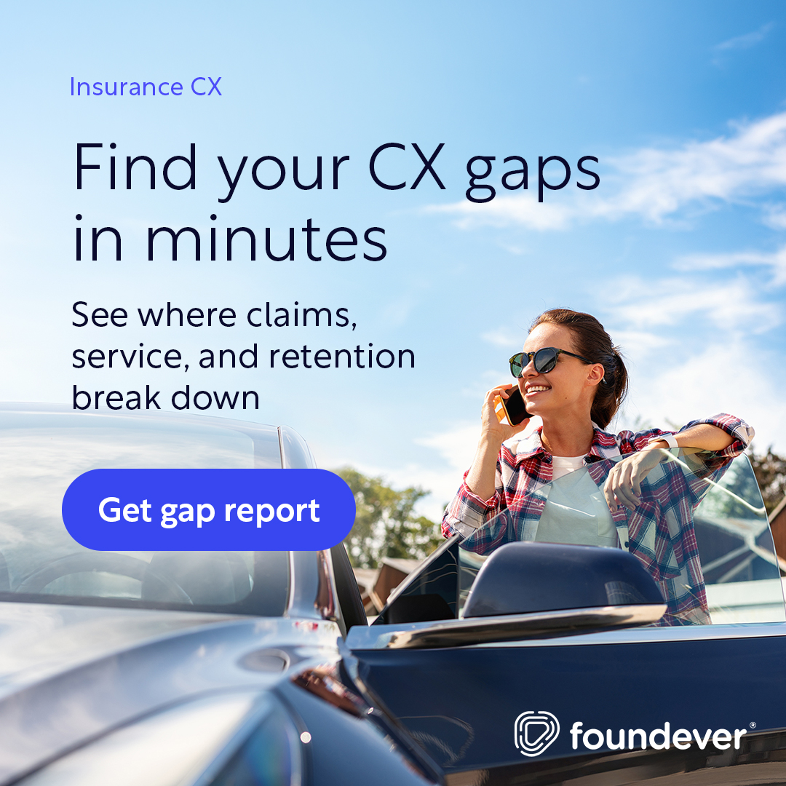
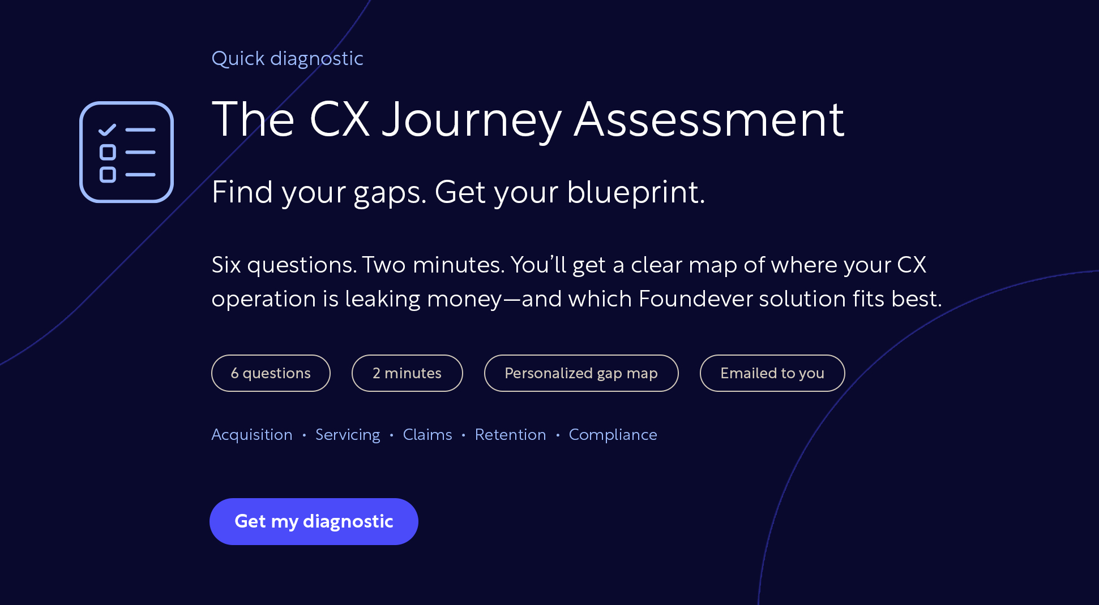
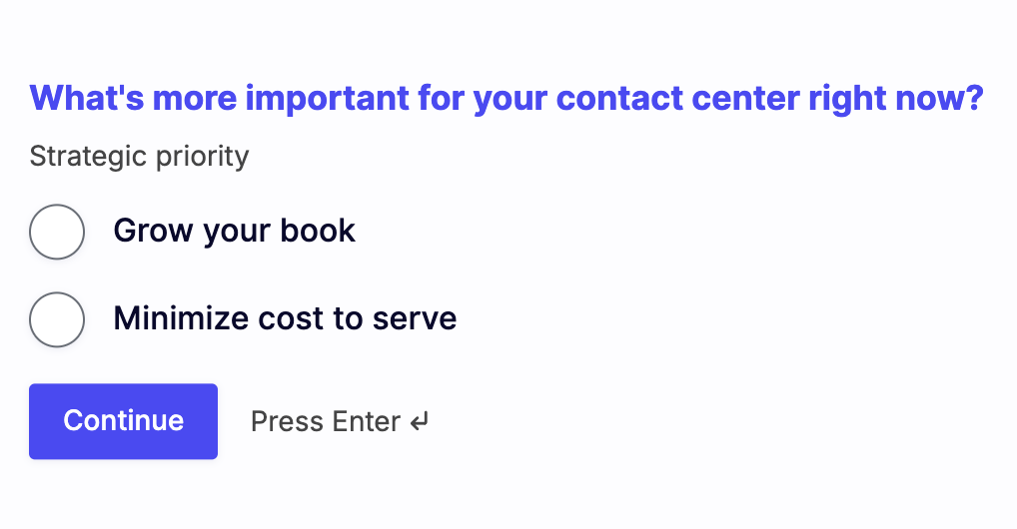
Lead generation journey
From ad impression to qualified meeting
Event
No Input
For context/
information
Distribution
Landing page
Diagnostic Quiz
Personalized Result
Activation across paid and owned channels.
Channels: LinkedIn Paid, Influ2, email
Audience: CX, COO, procurement
Success metrics: Impressions, CTR
Verticalised page (link), structured around insurance value props.
Six questions, two minutes, personalised result
Q0 routes Grow your book / Minimise cost to serve
5 stage-specific questions across customer journey
7 possible outcomes
7 results built per personalized scoring including:
Practical solutioning per case
Case studies for reference
Clear CTA for sales MQLs.

Slide 3




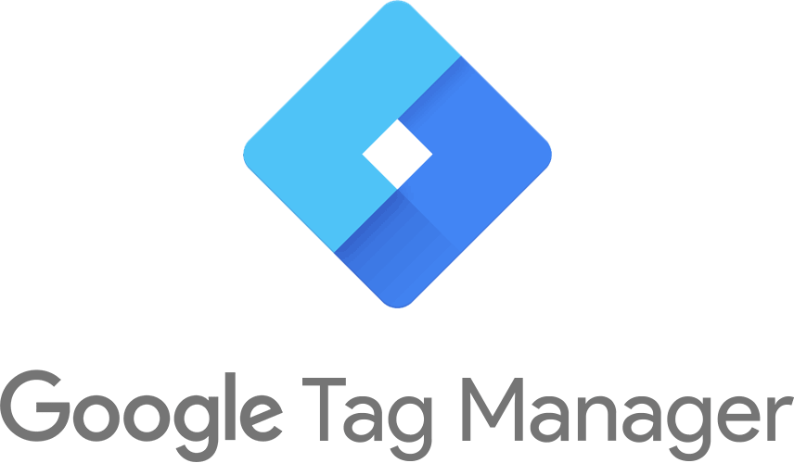

Workflows
Lead generation journey
Sales Report on engagements
Thank you page
Inside sales inbound motion
Results
Snapshot
Traffic sources
Converts
Influ2
ABM
Convert interest into meeting
LinkedIn
Organic
Landing Page
Visit
Quiz
Form fill via
LinkedIn
paid
Doesn’t convert
Doesn’t Convert
Direct Sales: Cassidy
SEA
intent
Retargeting cohort
LinkedIn + Influ2
Influ2 Cadance
Notes:
Executive Summary & Key Metrics
2–3 major achievements
1–2 key challenges or risks
At-a-glance dashboard: top KPIs (brand awareness, campaign reach, digital engagement, lead generation)

